Slide 1
CS 316: Introduction to Deep Learning
Convolutional Neural Networks and Pooling
Week 9
Dr Abdul Samad

Slide 2

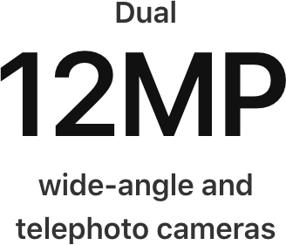
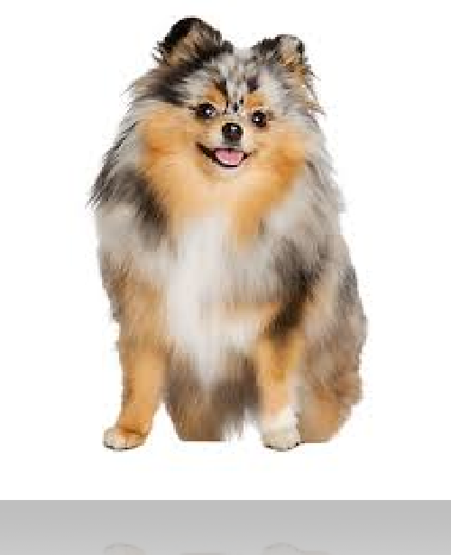
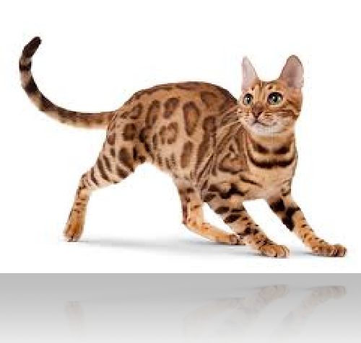
Classifying Dogs and Cats in Images
Use a good camera
RGB image has 36M elements
The model size of a single hidden layer MLP with a 1000 hidden units is 3.6 Billion parameters
Exceeds the population of dogs and cats on earth
(900M dogs + 700M cats)

Slide 3
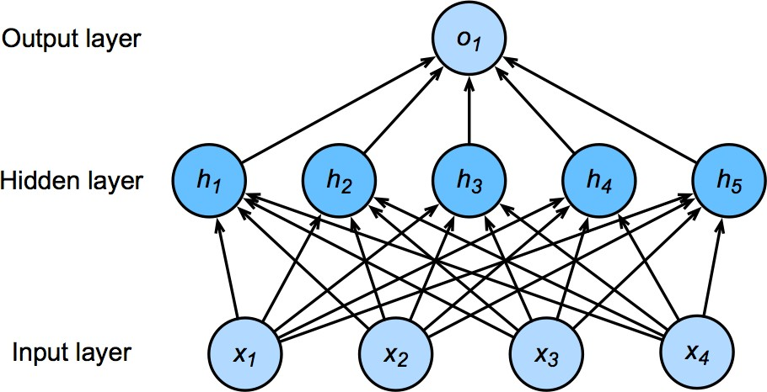
Flashback - Network with one hidden layer
Output layer
Hidden Layer
(1000 Neurons)
Input Layer
(36M Features)
3.6B parameters = 14GB

Slide 4
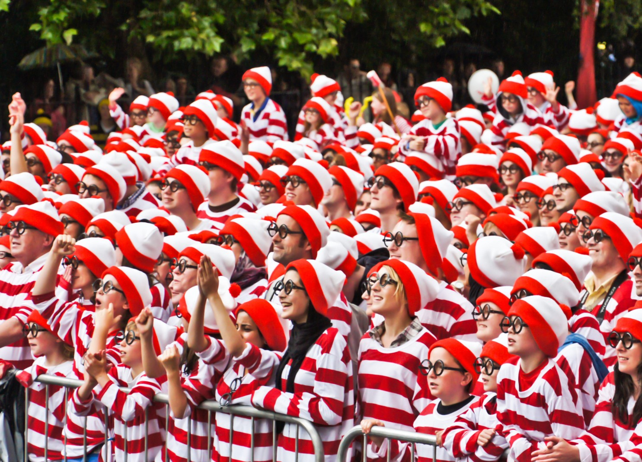


Where is Waldo?

Slide 5
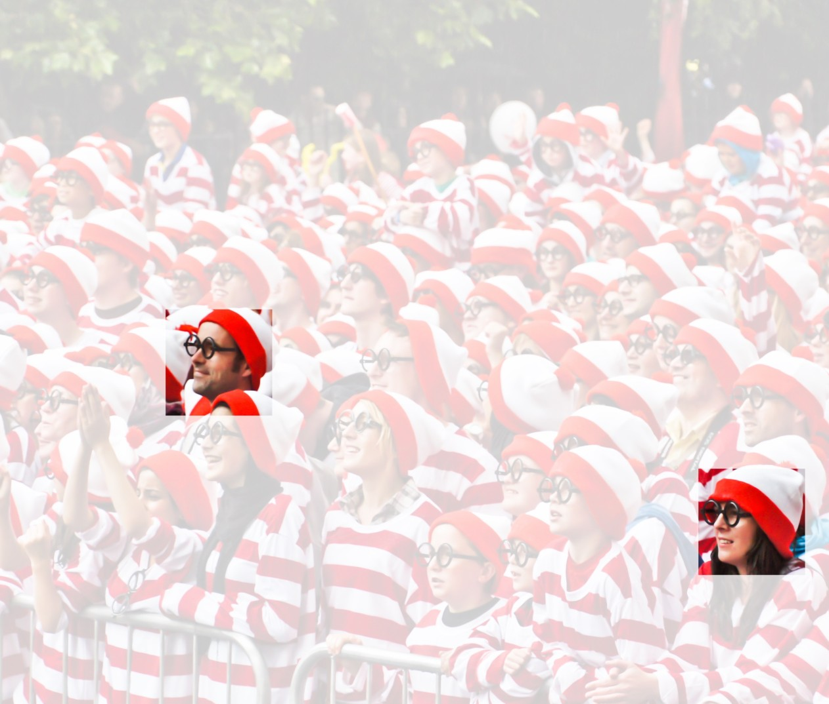
Two Principles
Translation Invariance
Locality
Notes:
In the earliest layers, our network should respond similarly to the same patch, regardless of where it appears in the image. This principle is called translation invariance.
The earliest layers of the network should focus on local regions, without regard for the contents of the image in distant regions. This is the locality principle. Eventually, these local representations can be aggregated to make predictions at the whole image level.

Slide 6
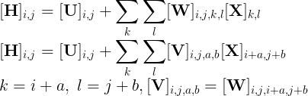
Rethinking Dense Layers
Reshape inputs and output into matrix (width, height) where indices run over both positive and negative values.
Notes:
MLP with two-dimensional images X as inputs and their immediate hidden representations H similarly represented as matrices in mathematics and as two-dimensional tensors in code, where both X and H have the same shape.
Let [X]i,jand [H]i,j denote the pixel at location (i, jj) in the input image and hidden representation, respectively.
For any given location (i, j) in the hidden representation [H]i,j, we compute its value by summing over pixels in x, centered around (i,j) and weighted by [V]i,j,a,b.

Slide 7

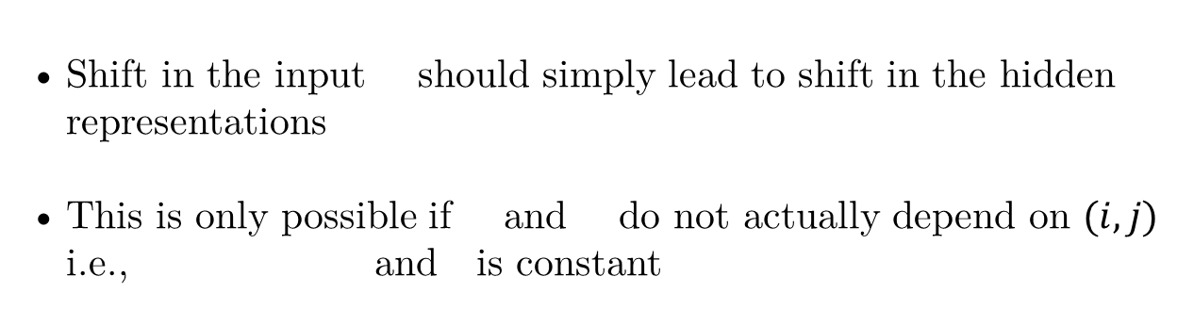
Translation Invariance
Shift in the input should simply lead to shift in the hidden representations
This is only possible if and do not actually depend on $(i,j)$ i.e., and is constant
Notes:
MLP with two-dimensional images X as inputs and their immediate hidden representations H similarly represented as matrices in mathematics and as two-dimensional tensors in code, where both X and H have the same shape.
Let [X]i,jand [H]i,j denote the pixel at location (i, jj) in the input image and hidden representation, respectively.
For any given location (i, j) in the hidden representation [H]i,j, we compute its value by summing over pixels in x, centered around (i,j) and weighted by [V]i,j,a,b.

Slide 8

Locality
We should not look very far from the location (i,j) , to extract information to assess what is going on at .
This means outside some range , or set
Notes:
MLP with two-dimensional images X as inputs and their immediate hidden representations H similarly represented as matrices in mathematics and as two-dimensional tensors in code, where both X and H have the same shape.
Let [X]i,jand [H]i,j denote the pixel at location (i, jj) in the input image and hidden representation, respectively.
For any given location (i, j) in the hidden representation [H]i,j, we compute its value by summing over pixels in x, centered around (i,j) and weighted by [V]i,j,a,b.

Slide 9
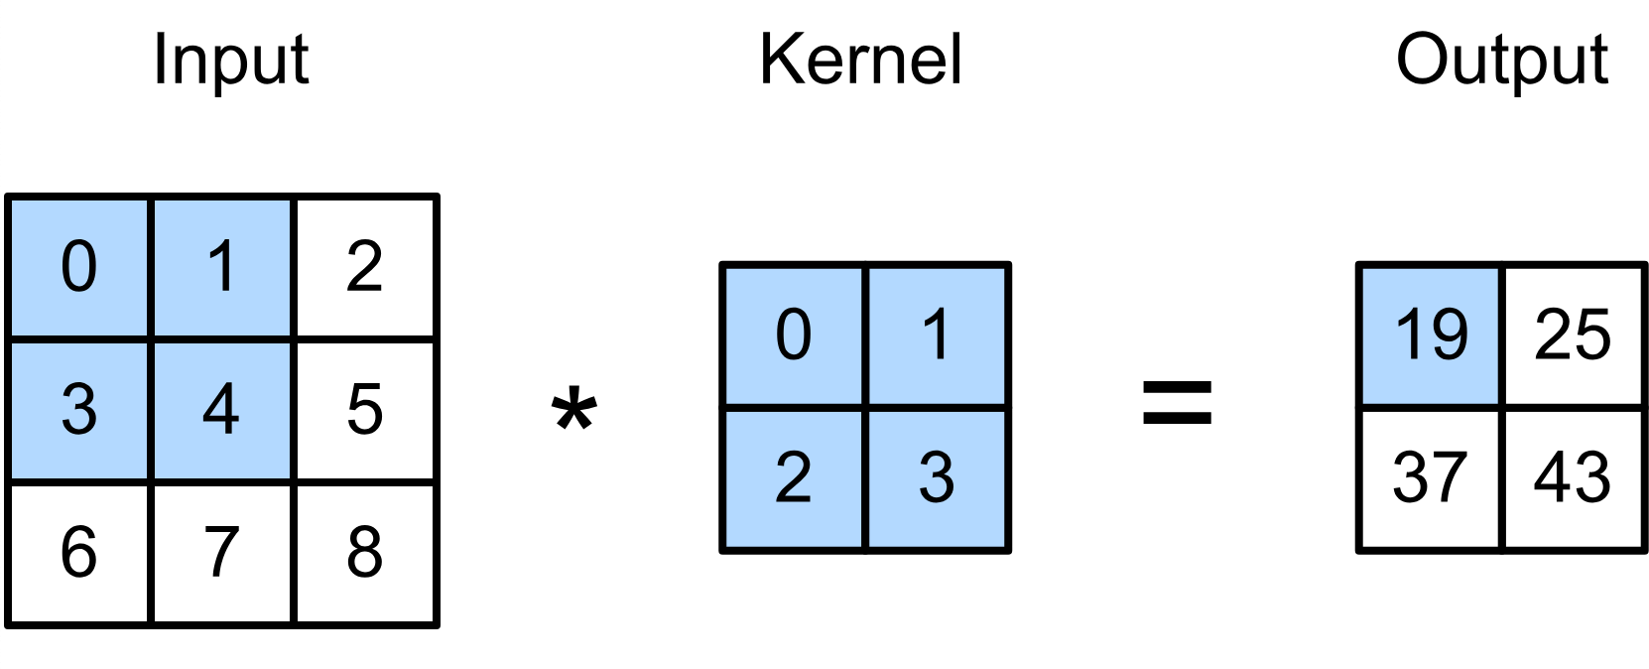
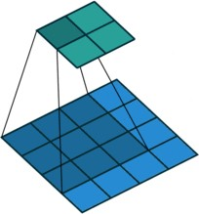
2-D Convolution
0 × 0 + 1 × 1 + 3 × 2 + 4 × 3 = 19
1 × 0 + 2 × 1 + 4 × 2 + 5 × 3 = 25
3 × 0 + 4 × 1 + 6 × 2 + 7 × 3 = 37
4 × 0 + 5 × 1 + 7 × 2 + 8 × 3 = 43
(vdumoulin@ Github)

Slide 10
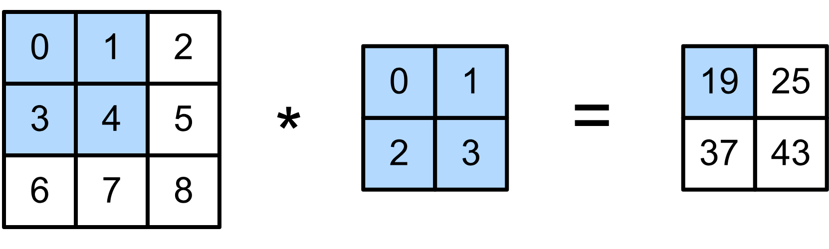
2-D Convolution Layer
Input matrix
Kernel matrix
Output Matrix
Notes:
the convolutional layer output in Fig. 6.2.1 is sometimes called a feature map, as it can be regarded as the learned representations (features) in the spatial dimensions (e.g., width and height) to the subsequent layer.
In CNNs, for any element xx of some layer, its receptive field refers to all the elements (from all the previous layers) that may affect the calculation of xx during the forward propagation

Slide 11
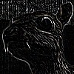
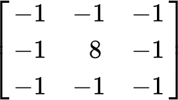
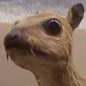
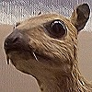
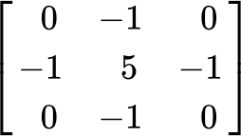

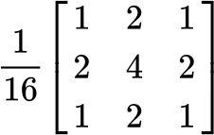
Examples
Edge Detection
Sharpen
(wikipedia)
Gaussian Blur

Slide 12
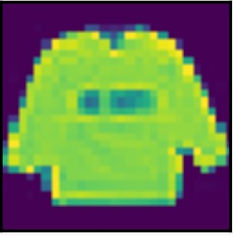

Padding
Given a 32 x 32 input image
Apply convolutional layer with 5 x 5 kernel
28 x 28 output with 1 layer
4 x 4 output with 7 layers
Shape decreases faster with larger kernels
Shape reduces from to

Slide 13
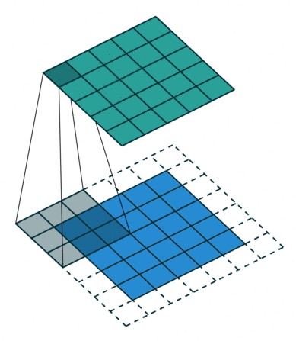
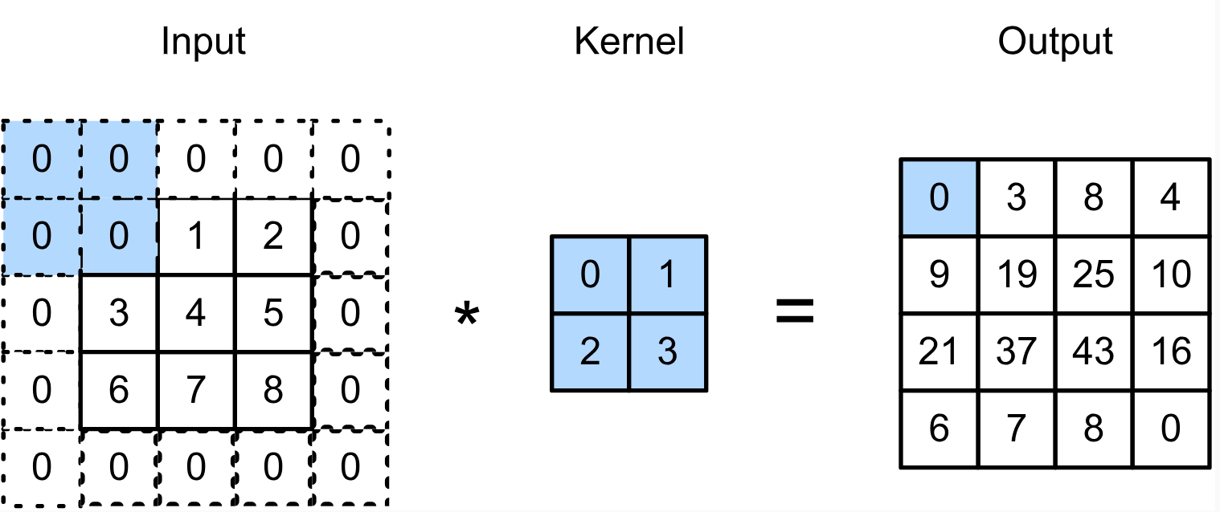
Padding
Padding adds rows/columns around input.
0 × 0 + 0 × 1 + 0 × 2 + 0 × 3 = 0

Slide 14
Padding
Padding p_{h} rows and p_{w} columns, output shape will be
(n_{h} − k_{h} + p_{h} + 1) × (n_{w} − k_{w} + p_{w} + 1)
A common choice is p_{h} = k_{h} − 1 and p_{w} = k_{w} − 1

Slide 15

Stride
Padding reduces shape linearly with #layers
Given a 224 x 224 input with a 5 x 5 kernel, needs 44 layers to reduce the shape to 4 x 4
Requires a large amount of computation

Slide 16
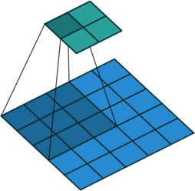
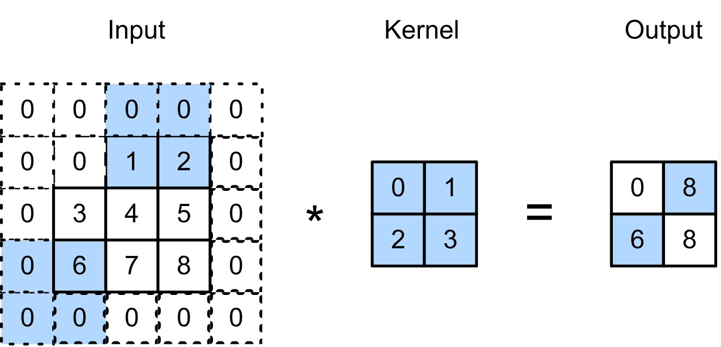
Stride
Stride is the #rows/#columns per slide.
Strides of 3 and 2 for height and width
0 × 0 + 0 × 1 + 1 × 2 + 2 × 3 = 8
0 × 0 + 6 × 1 + 0 × 2 + 0 × 3 = 6

Slide 17
Stride
Given stride s_{h} for the height and stride s_{w} for the width, the output shape is
⌊(n_{h} − k_{h} + p_{h} + s_{h})/s_{h}⌋ × ⌊(n_{w} − k_{w} + p_{w} + s_{w})/s_{w}⌋
With p_{h} = k_{h} − 1 and
p_{w} = k_{w} − 1
⌊(n_{h} + s_{h} − 1)/s_{h}⌋ × ⌊(n_{w} + s_{w} − 1)/s_{w}⌋
If input height/width are divisible by strides
(n_{h} /s_{h}) × (n_{w} /s_{w})

Slide 18
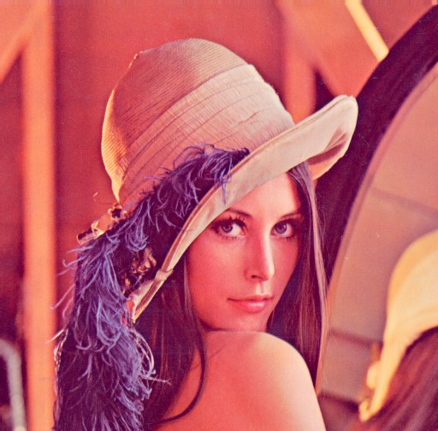
Multiple Input Channels
Color image may have three RGB channels
Converting to grayscale loses information

Slide 19
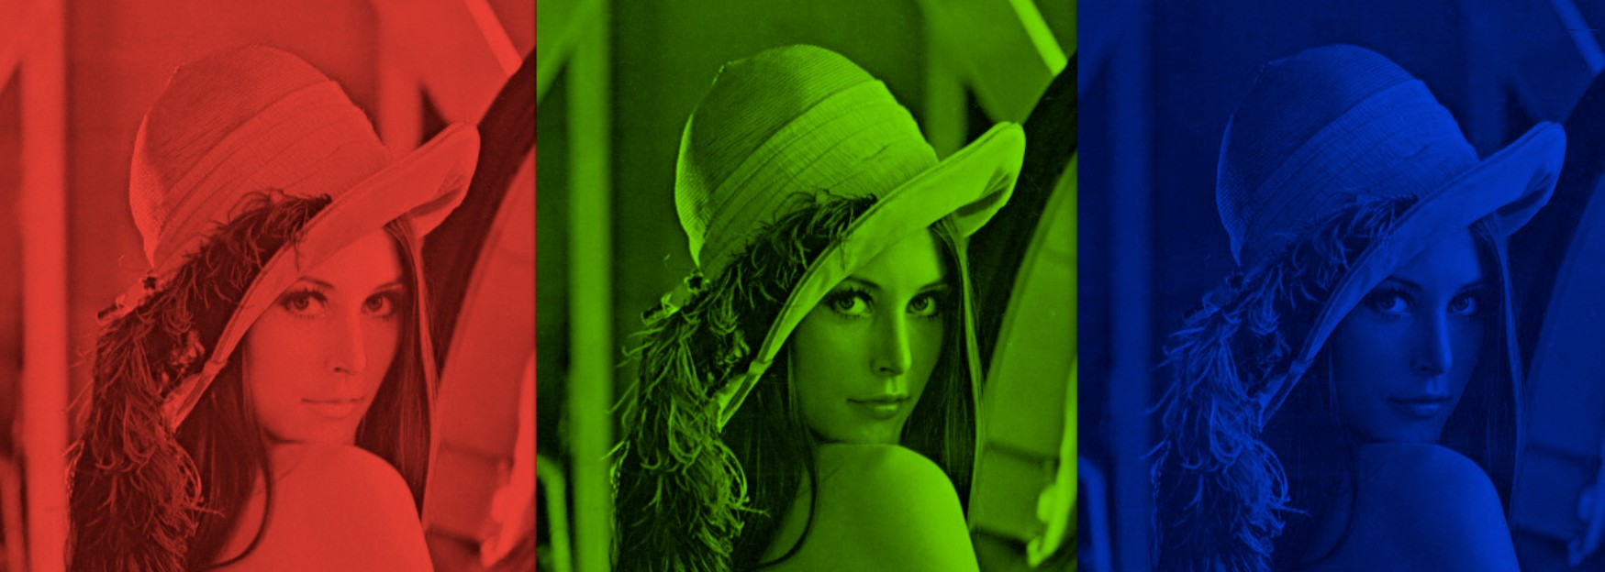
Multiple Input Channels
Color image may have three RGB channels
Converting to grayscale loses information
courses.d2l.ai/berkeley-stat-157

Slide 20
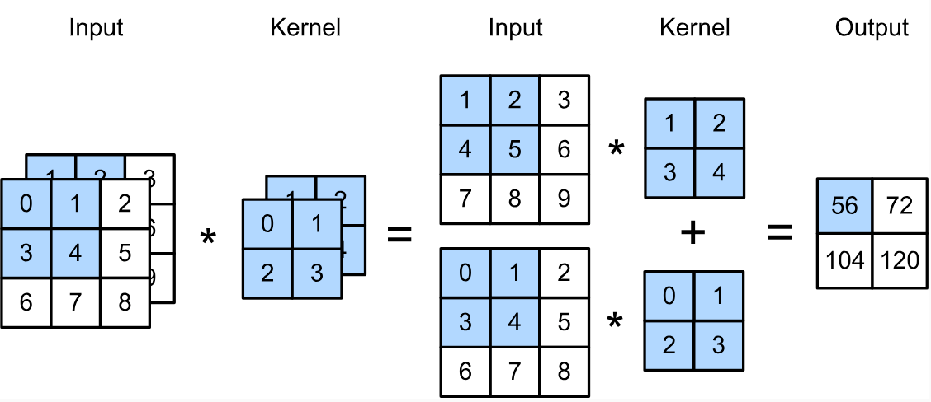
Multiple Input Channels
Have a kernel for each channel, and then sum results over channels.
(1 × 1 + 2 × 2 + 4 × 3 + 5 × 4) +(0 × 0 + 1 × 1 + 3 × 2 + 4 × 3) = 56

Slide 21
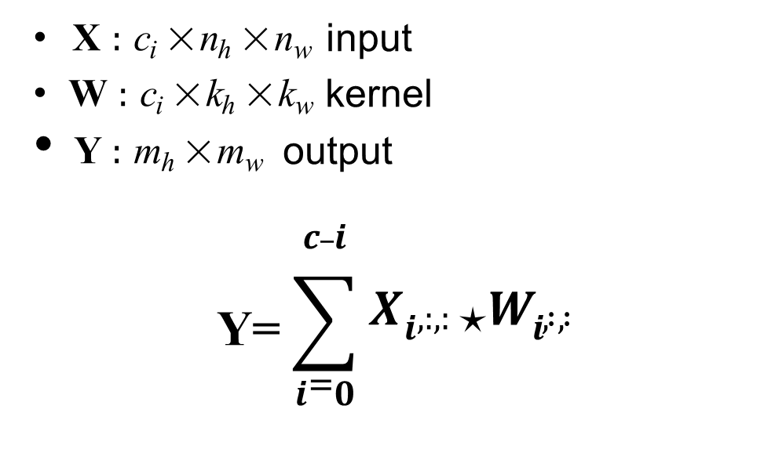
Multiple Input Channels
X : c_{i} × n_{h} × n_{w} input
W : c_{i} × k_{h} × k_{w} kernel
Y : m_{h} × m_{w} output
$$\text{Y}\text{=}\sum_{i=0}^{c_i}{X_{i,:,:}\text{⋆}W_{i, : , :}}$$

Slide 22
Multiple Output Channels
No matter how many inputs channels, so far we always get single output channel
We can have multiple 3-D kernels, each one generates a output channel
Input X : c_{i} × n_{h} × n_{w}
Kernel W : c_{o} × c_{i} × k_{h} × k_{w}
Output Y : c_{o} × m_{h} × m_{w}
^{Y}i,:,: ^{= X ⋆ W}i,:,:,:
for i = 1,…, c_{o}

Slide 23
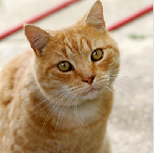






Multiple Input/Output Channels
Each output channel may recognize a particular pattern.
Input channels kernels recognize and combines patterns in inputs

Slide 24
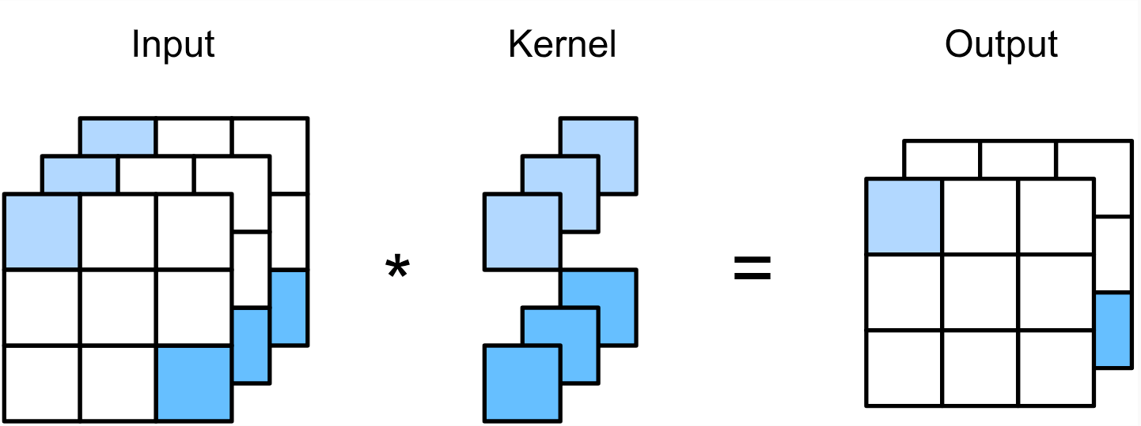
1 x 1 Convolutional Layer
k_{h} = k_{w} = 1 is a popular choice. It doesn’t recognize spatial patterns, but fuse channels.
Equal to a dense layer with nhnw×cin input and
c_{o} × c_{i} weight.

Slide 25
2-D Convolution Layer Summary
Input
Kernel
Bias
Output
X : c_{i} × n_{h} × n_{w}
W : c_{o} × c_{i} × k_{h} × k_{w}
B : c_{o} × c_{i}
Y = X ⋆ W + B
Y : c_{o} × m_{h} × m_{w}
Complexity (number of floating point operations FLOP)
c_{i} = c_{o} = 100
k_{h} = h_{w} = 5
O(c_{i}c_{o}k_{h}k_{w}m_{h}m_{w})
1GFLOP
m_{h} = m_{w} = 64
10 layers, 1M examples: 10PF
(CPU: 0.15 TF = 18h, GPU: 12 TF = 14min)

Slide 26
Pooling
Convolution is sensitive to position
Detect vertical edges
We need some degree of invariance to translation
Lighting, object positions, scales, appearance vary among images
Notes:
Why to use Pooling Layers?
Pooling layers are used to reduce the dimensions of the feature maps. Thus, it reduces the number of parameters to learn and the amount of computation performed in the network.
The pooling layer summarises the features present in a region of the feature map generated by a convolution layer. So, further operations are performed on summarised features instead of precisely positioned features generated by the convolution layer. This makes the model more robust to variations in the position of the features in the input image.

Slide 27
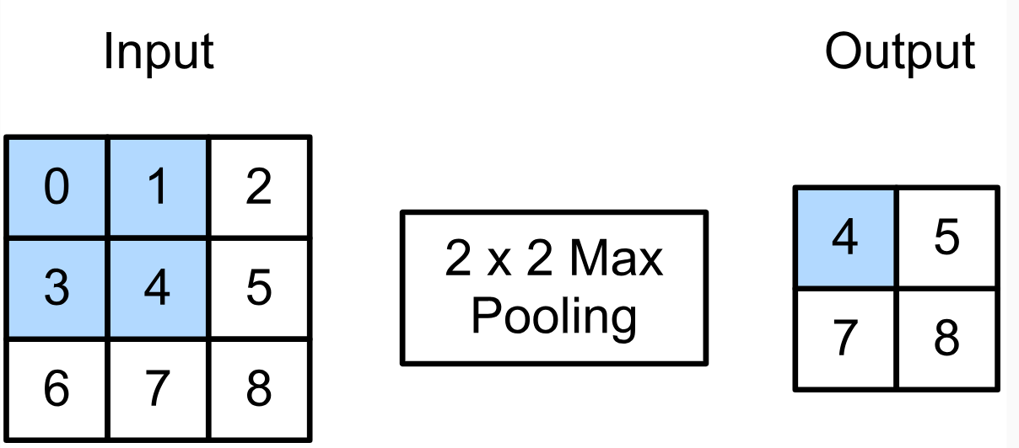
2-D Max Pooling
Returns the maximal value in the sliding window.
Max(0,1,3,4) = 4

Slide 28
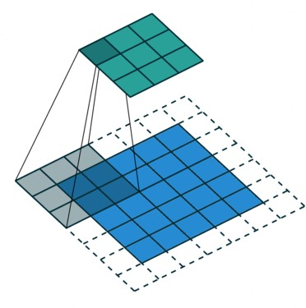
Padding, Stride, and Multiple Channels
Pooling layers have similar padding and stride as convolutional layers.
No learnable parameters
Apply pooling for each input channel to obtain the corresponding output channel.
#Ouput Channels = # Input Channels

Slide 29
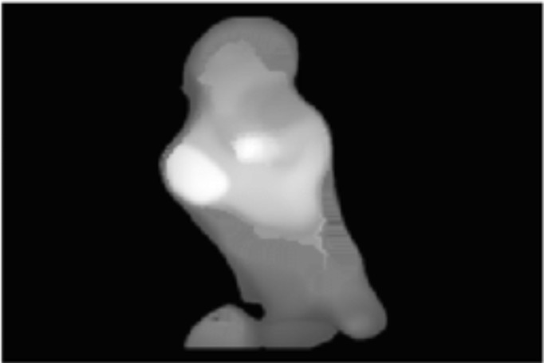
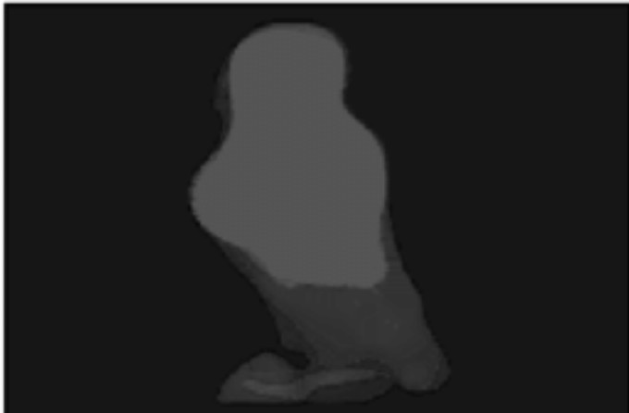
Average Pooling
Max pooling
The strongest pattern signal in a window
Average pooling
The average signal strength in a window i.e., replace max with mean in max pooling
Max pooling
Average pooling

Slide 30
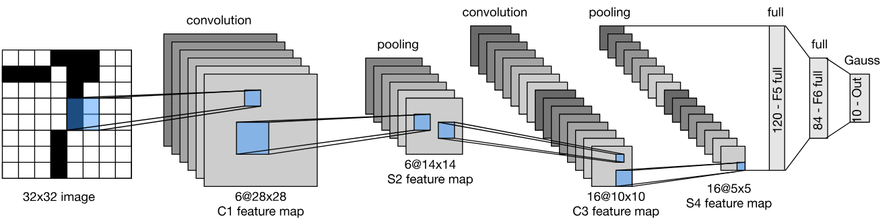
LeNet Architecture

Slide 31
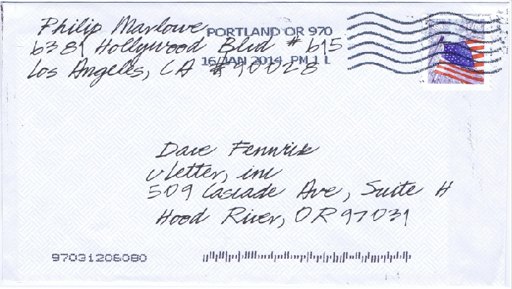
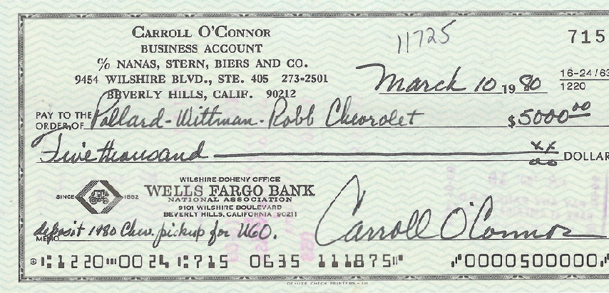
Handwritten Digit Recognition

Slide 32
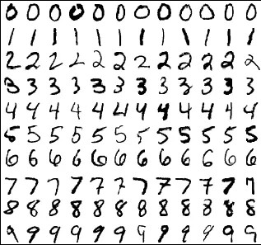
MNIST
Centered and scaled
50,000 training data
10,000 test data
28 x 28 images
10 classes

Slide 33
Expensive if we have many outputs

Slide 34
Summary
Convolutional layer
Reduced model capacity compared to dense layer
Efficient at detecting spatial pattens
High computation complexity
Control output shape via padding, strides and channels
Max/Average Pooling layer
Provides some degree of invariance to translation

